Slide 1
A phase 1 dose expansion study of a first-in-class KAT6 inhibitor — PF-07248144 in patients with advanced or metastatic ER+ HER2− breast cancer
Toru Mukohara,¹ Yeon Hee Park,² David Sommerhalder,³ Kan Yonemori,⁴ Sung-Bae Kim,⁵ Jee Hyun Kim,⁶ Hiroji Iwata,⁷ Toshinari Yamashita,⁸ Rachel M. Layman,⁹ Gun Min Kim, ¹⁰ Seock-Ah Im,¹¹ Geoffrey J. Lindeman,¹² Hope S. Rugo,¹³ Marlon Liyanage,¹⁴ Natasha Homji Mishra,¹⁵ Arnab Kumar Maity,¹⁴ Orlaith Bogg,¹⁶ Li Liu,¹⁴ Meng Li,¹⁵ Patricia M. LoRusso¹⁷
¹National Cancer Center Hospital East, Kashiwa, Japan; ²Samsung Medical Center, Sungkyunkwan University School of Medicine, Seoul, Republic of Korea; ³NEXT Oncology, San Antonio, TX, USA; ⁴National Cancer Center Hospital, Tokyo, Japan; ⁵Asan Medical Center, University of Ulsan College of Medicine, Seoul, Republic of Korea; ⁶Seoul National University Bundang Hospital, Seoul National University College of Medicine, Seongnam, Republic of Korea; ⁷Aichi Cancer Center, Nagoya, Japan; ⁸Kanagawa Cancer Center, Yokohama, Japan; ⁹The University of Texas MD Anderson Cancer Center, Houston, TX, USA; ¹⁰Yonsei University Health System, Seoul, Republic of Korea; ¹¹Seoul National University Hospital, Seoul, Republic of Korea; ¹²Peter MacCallum Cancer Centre, Melbourne, Australia; ¹³University of California, San Francisco, CA, USA; ¹⁴Pfizer Inc, San Diego, CA, USA; ¹⁵Pfizer Inc, San Francisco, CA, USA; ¹⁶Pfizer Inc, Fort Lee, NJ, USA; ¹⁷Yale School of Medicine, New Haven, CT, USA
Presenter: Patricia M. LoRusso DO, PhD, FAACR, FASCO, Yale School of Medicine
Patricia M. LoRusso, DO

Slide 2
Disclosures
Will be displayed automatically based on information provided to ASCO

Slide 3
Key Takeaways
PF-07248144: first-in-class, potent, selective catalytic inhibitor of KAT6A and 6B
Phase 1 (NCT04606446):
Dose escalation established 5 mg QD as the RDE
Dose expansion evaluated monotherapy and fulvestrant combination post CDK4/6 inhibitors and ET
Tolerable safety profile at RDE
Encouraging activity both as monotherapy and fulvestrant combination
Fulvestrant combination: consistent activity in patients treated in the 2L and 3L+, irrespective of ESR1, PIK3CA, AKT1, and PTEN mutation status
These findings establish KAT6A and 6B as druggable cancer targets and identify a potential new path to treat patients with HR+ mBC
ET=endocrine therapy; HR+ mBC=hormone receptor–positive metastatic breast cancer; L= line; QD=once daily; RDE=recommended dose for expansion Data cutoff: September 30, 2023

Slide 4
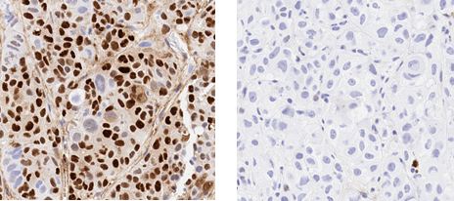
PF-07248144: First-in-Class, Potent, Selective KAT6 A/B Inhibitor for HR+ Breast Cancer
Mechanism of Action
PF-07248144 Suppresses ER Expression (Murine Xenograft)
¹
KAT6A inhibition represses ER transcription and hence also overcomes ESR1 mutants that confer resistance to ET
Orthogonal inhibition of other oncogenic pathways driving HR+ breast cancer (eg, cell cycle, Myc)
Vehicle
3 mg/kg oral
ER (IHC)
ZR-75-1 ER+/HER2-
EAF6
ING5
Potent Antitumor Activity in ER+/HER2-PDX models
PF-07248144
ST3164B ER+/HER2- PDX pretreated with palbociclib + letrozole
KAT6A
KAT6B
1000
PF-07248144 vehicle
PF-07248144: 0.3 mg/kg
PF-07248144: 3 mg/kg
BRPF1
Ac
Ac
Ac
Tumor volume (mm³)
Estrogen signaling, cell cycle regulation
500
0
0
14
28
42
56
Sharma S, et al. Cell Chem Biol 30,1191-1210.e20 (2023).
Time (day)
ER=estrogen receptor; ER+ HER2−=estrogen receptor–positive human epidermal growth factor receptor 2–negative; ET=endocrine therapy; PDX=patient-derived xenograft
Notes:
KAT6A, and its paralog, KAT6B, are histone lysine acetyltransferases (KATs) that regulate lineage specific gene transcription via H3K23 acetylation (H3K23Ac)
PF-07248144: first-in-class, potent, selective catalytic inhibitor of KAT6A and 6B
PF-07248144 has showed antitumor activity in ER+ breast cancer patient-derived xenograft (PDX) models (including the ones harboring ESR1 and PIK3CA mutations) and enhanced antitumor activity in combination with fulvestrant
Potential Mechanism of Action of KAT6 inhibitor:
Represses ER transcription and thus also overcomes ESR1 mutants that confer resistance to endocrine therapy in addition to ESR1 wildtype
Inhibits other oncogenic pathways as well driving HR+ breast cancer, including cell cycle and Myc signalling pathway

Slide 5
Dose Escalation Identified 5 mg QD as RDE
Open-label, multicenter, Phase 1 study^{1,2}
Part 1A: Dose escalation monotherapy (1–15 mg QD)
Part 1B: Combination with fulvestrant (5 mg QD)
Enriched in ER+ HER2– mBC, who progressed after prior CDK4/6i and ET
Most frequent grade ≥3 TRAEs were hematologic toxicities, manageable with dose modifications
MTD not reached
Part 1 Dose Escalation:
ER+HER2− mBC, CRPC, or NSCLC
Part 1A
PF-07248144 monotherapy
Part 1B
PF-07248144 + fulvestrant
Cohort 5
(1 mg QD, n=8)
PF-07248144 at 5 mg QD and fulvestrant 500 mg
2L+ ER+HER2− mBC progressed after
CDK4/6i + ET
(5 mg QD, n=9)
Cohort 4
(2 mg QD, n=4)
Cohort 3
(5 mg QD, n=4)
Cohort 2
(15 mg QD, n=6)
Cohort 1
(8 mg QD, n=7)
1. Study of PF-07248144 in advanced or metastatic solid tumors (KAT6). Accessed May 23, 2024. https://classic.clinicaltrials.gov/ct2/show/NCT04606446. 2. Sommerhalder D, et al. JCO 2023;41(16_suppl):1054. Data cutoff: September 30, 2023. ER+ HER2− mBC=estrogen receptor–positive human epidermal growth factor receptor 2–negative metastatic breast cancer; ET=endocrine therapy; L=line; MTD=maximum tolerated dose; QD=once daily; RDE=recommended dose for expansion; TRAE=treatment-related adverse event
Notes:
PF-07248144 is an oral agent taken by mouth once a day.
The phase 1 first in human trial is to evaluate patient safety, PK/PD to identify recommendation dose to evaluate clinical efficacy in dose expansion.
In dose escalation,
we have evaluated 5 dose levels at 1, 2,5,8 and 15 mg QD in three tumor indications (NSCLC, CRPC and ER+ HER2- MBC) and enriched in ER+ HER2- mBC who progressed after prior CDK4/6i and ET
Data cutoff was 30 Sep 2023.

Slide 6
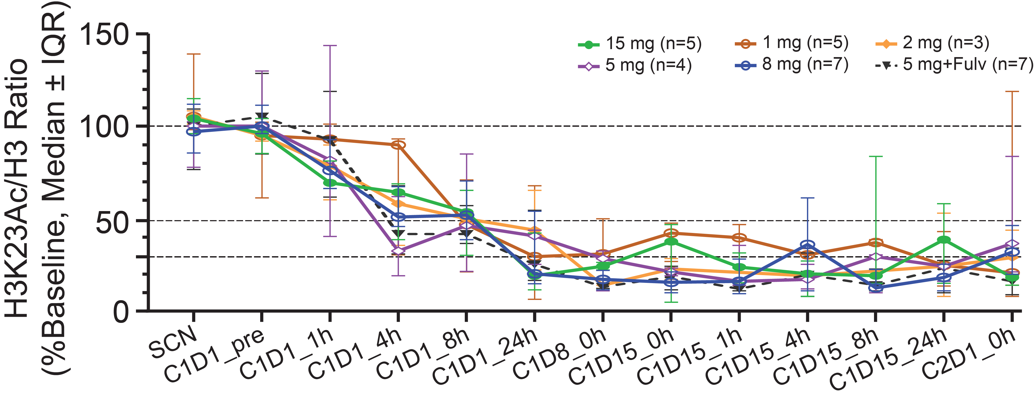
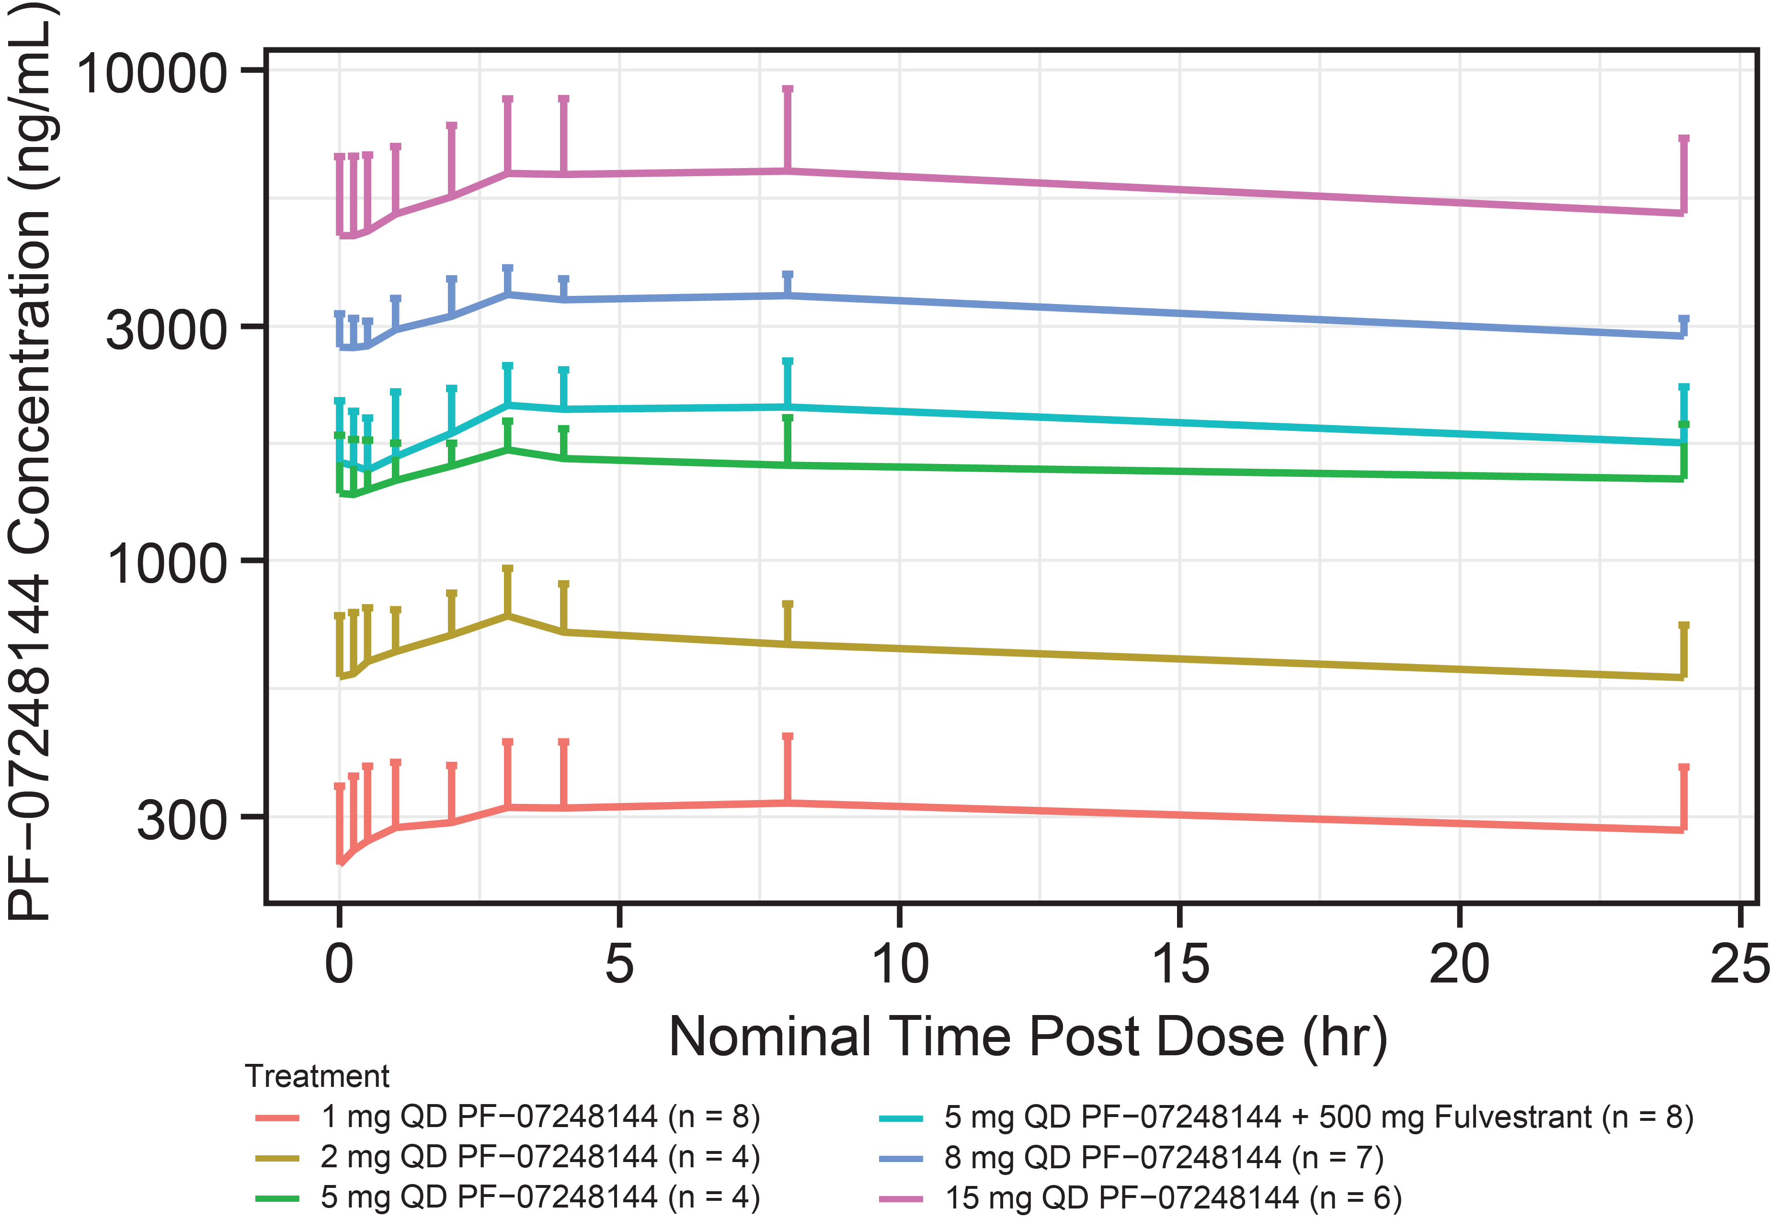
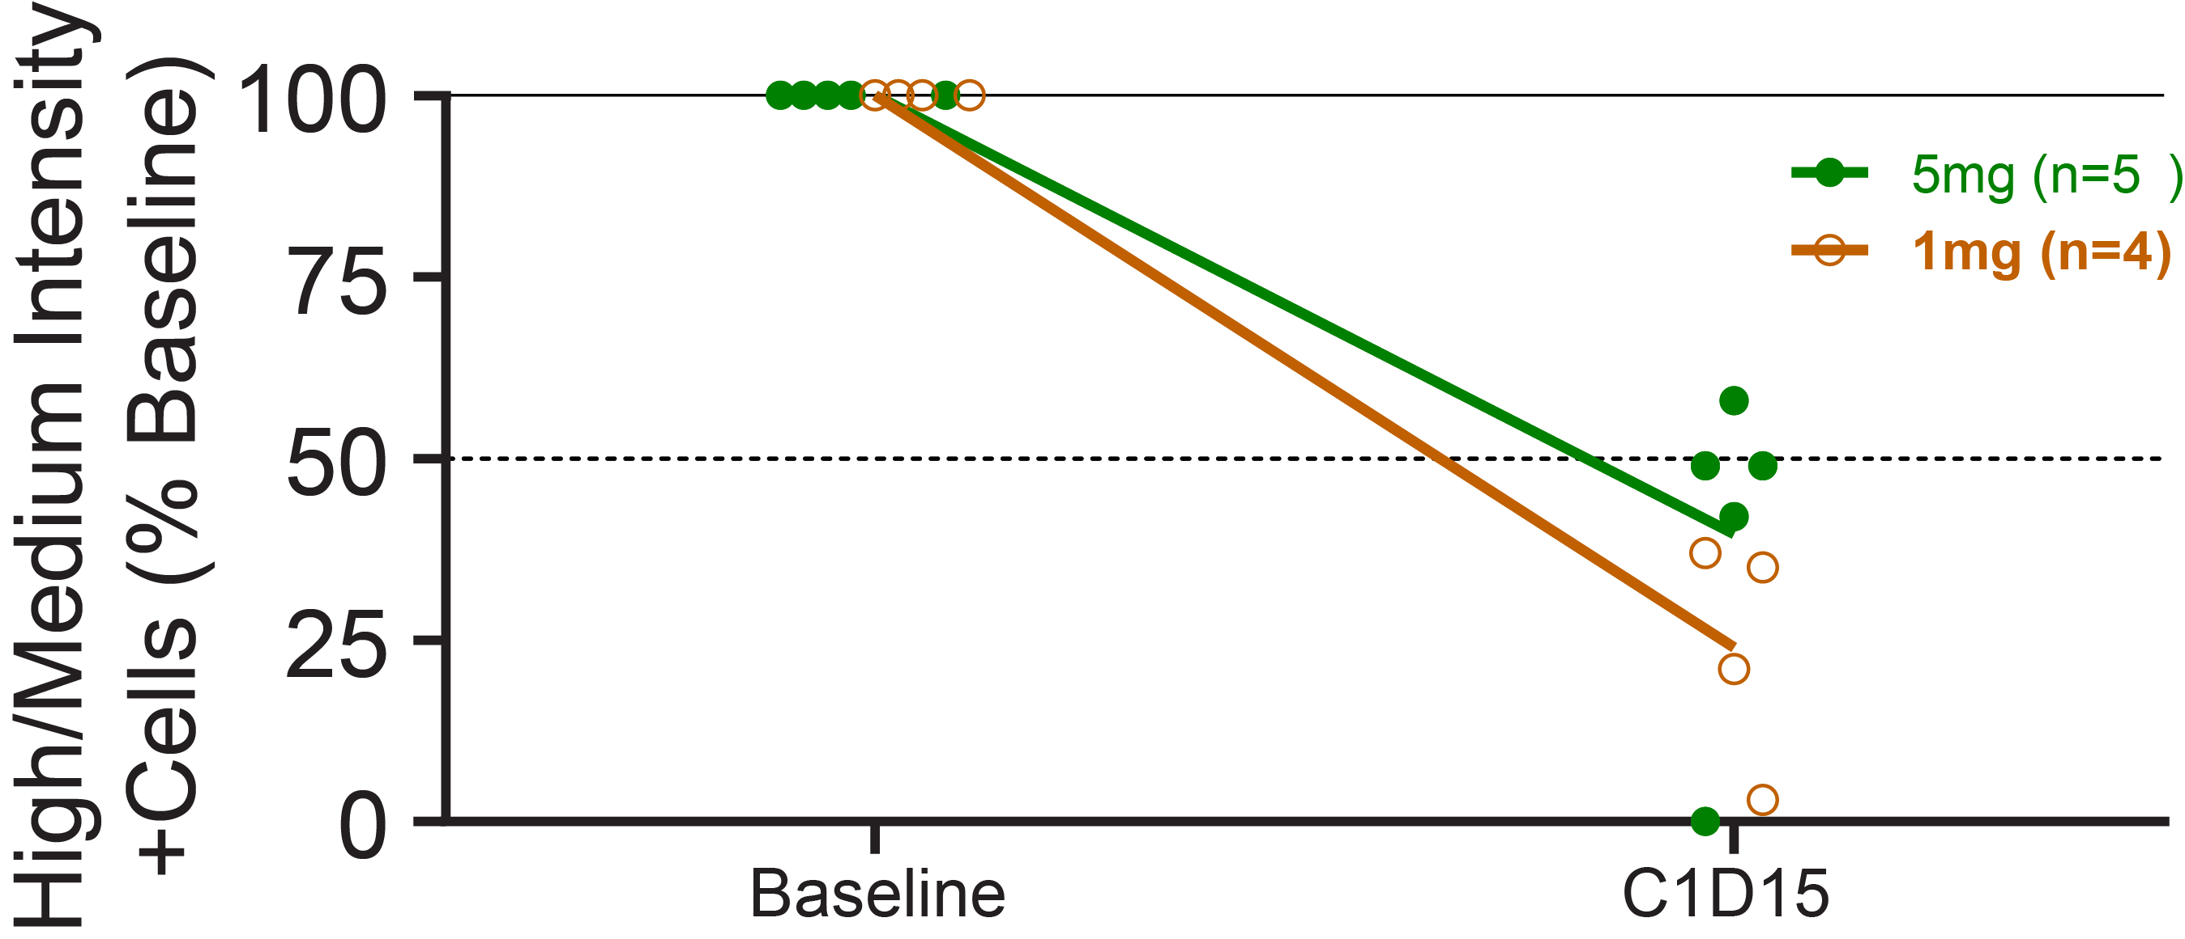
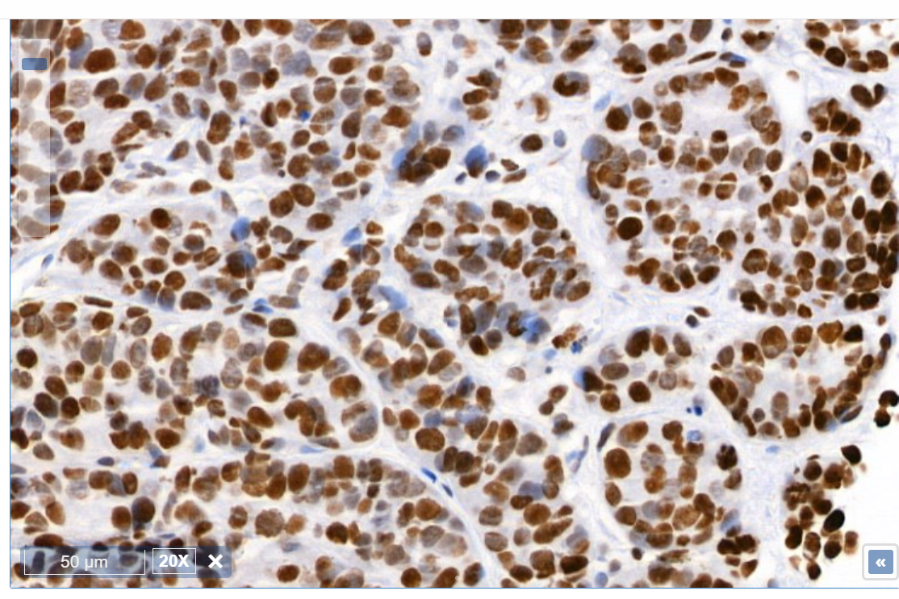
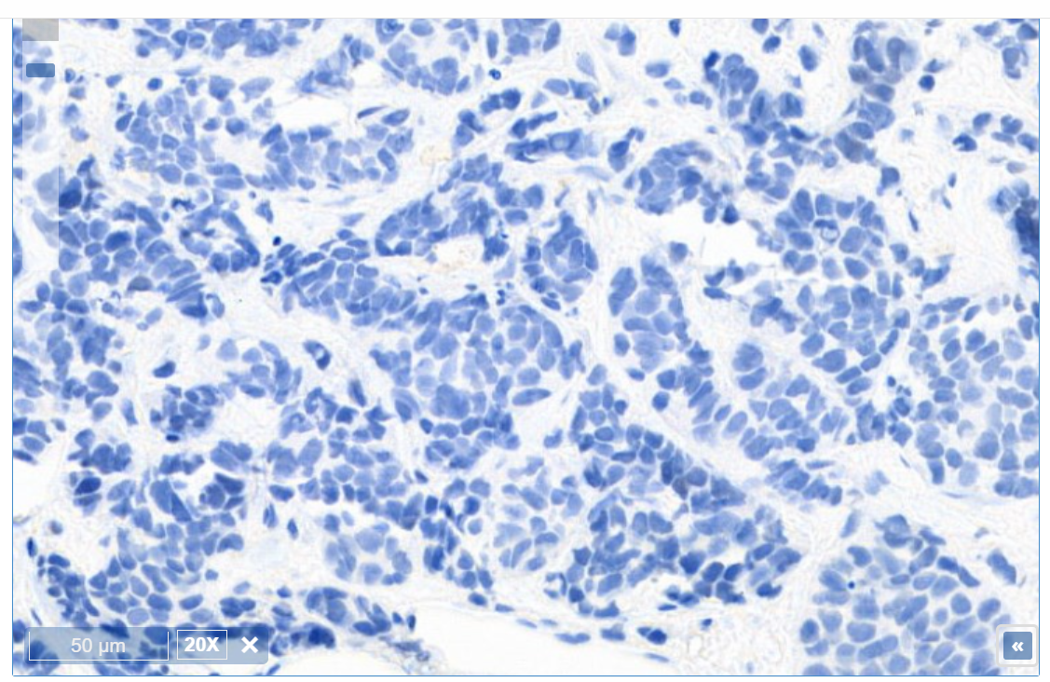
Linear PK & Strong H3K23Ac PD Reduction Achieved at Clinical Dose Range
Steady-state concentration-time profile of PF-07248144 (C1D15)
PF-07248144 reduction of H3K23Ac in PBMC
H3K23Ac PD Reduction in Tumor
PF-07248144 at 5 mg QD, 20X
Baseline
C1D15
Scale bar: 50µm
5 mg QD was selected as RDE for PF-07248144 monotherapy and fulvestrant combination based on safety, PK, PD, and preliminary efficacy
C=Cycle; D=Day; H3K23Ac=histone 3 lysine 23 acetylation; IQR=interquartile range; PBMC=peripheral blood mononuclear cell; PD=pharmacodynamic; PK=pharmacokinetic; QD=once daily; RDE=recommended dose for expansion
Notes:
During phase 1 dose escalation study, PF-07248144 (Kat6 inhibitor) showed linear PK from 1 mg to 15 mg QD.
Kat6 inhibitor also demonstrated maximal blood H3K23Ac inhibition across all dose levels, and potent tumor PD inhibition at both 1 mg QD and 5 mg QD
5 mg QD was selected as recommended dose for expansion (RDE) for PF-07248144 monotherapy and fulvestrant combination based on safety, PK, PD, and preliminary efficacy

Slide 7
Monotherapy and Fulvestrant Combination at RDE
Objective
To evaluate safety, pharmacodynamics, and efficacy of PF-07248144 at RDE 5 mg QD in:
Monotherapy: Part 2A
Combination with fulvestrant 500 mg: Parts 1B+2B
Patient eligibility
ER+ HER2− mBC
Part 1B, Part 2A: 2L+, progressed after ≥1 prior CDK4/6 inhibitor and ≥1 prior ET
Part 2B: 2-4L, progressed after ≥1 prior CDK4/6 inhibitor and ≥1 prior ET; no more than 3 prior lines in metastatic setting
ECOG PS 0 or 1
Part 2 Dose Expansion:
PF-07248144 monotherapy and in combination with fulvestrant in ER+ HER2− mBC
Part 1B
PF-07248144 + fulvestrant
Part 2A
PF-07248144 monotherapy
2L+ ER+ HER2− mBC
progressed after CDK4/6i + ET
PF-07248144 5 mg QD
(n=35)
PF-07248144 at 5 mg QD and fulvestrant 500 mg
2L+ ER+ HER2− mBC progressed after
CDK4/6i + ET
(n=9)
Part 2B
PF-07248144 + fulvestrant
2–4L ER+ HER2− mBC
progressed after CDK4/6i + ET
PF-07248144 at 5 mg QD and fulvestrant 500 mg
(n=34)
ECOG PS=Eastern Cooperative Oncology Group performance status; ER+ HER2− mBC=estrogen receptor–positive human epidermal growth factor receptor 2–negative metastatic breast cancer; ET=endocrine therapy; L=line; QD=once daily; RDE=recommended dose for expansion

Slide 8
Baseline Characteristics: PF-07248144 5 mg QD Monotherapy
Age: Median 57.0 years
(range 39.0–76.0)
Female: 35 (100%)
Race: Asian (74.3%) White (25.7%)
ECOG PS: 0 (51.4%) 1 (48.6%)
Prior Therapies | Monotherapy PF-07248144 5 mg QD Part 2A (N=35)
Systemic therapy in advanced/metastatic setting, median (range) | 5.0 (1–13)
Prior CDK4/6 inhibitors, n (%) | 35 (100)
Prior CDK4/6 inhibitors >12 months | 19 (54.3)
Prior ET in advanced/metastatic setting, median (range) | 2.0 (1–7)
Prior ET, n (%) | 35 (100)
Prior aromatase inhibitors, n (%) | 30 (85.7)
Prior fulvestrant, n (%) | 28 (80.0)
Prior chemotherapies in advanced/metastatic setting, median (range) | 1.0 (0–8)
Prior chemotherapy, n (%) | 26 (74.3)
Prior other targeted therapies (mTOR and PIK), n (%) | 14 (40.0)
ESR1 mutant, n/N (%) | 22/35 (62.9)
ECOG PS=Eastern Cooperative Oncology Group performance status; ET=endocrine therapy; mTOR=mammalian target of rapamycin; PIK=phosphoinositide kinases; QD=once daily
Notes:
[[DRAFT]]
35 patients with ER+ HER2- mBC received PF-07248144 as monotherapy at 5 mg QD, the monotherapy recommended dose for expansion
The median (range) age was 57.0 years (39.0–76.0)
All 35 (100%) were female
Median prior lines of systemic therapy in the metastatic setting were 5, ranged 1–13

Slide 9
Tolerable Safety: PF-07248144 5 mg QD Monotherapy
Most frequent TRAEs (≥20%) | Monotherapy PF-07248144 5 mg QD (N=35)
By Preferred Term, n (%) of patients with any adverse event | All grade | Grade ≥3
With Any Adverse Event | 33 (94.3) | 19 (54.3)
Dysgeusia | G1:26 (74.3) G 2: 4 (11.4) | 0
Neutropenia | 24 (68.6) | G3:12(34.3) G4: 2 (5.7)
Anemia | 16 (45.7) | 3 (8.6)
Leukopenia | 16 (45.7) | 4 (11.4)
Thrombocytopenia | 13 (37.1) | 0
Aspartate aminotransferase increased | 8 (22.9) | 0
Median follow-up: 15.9 months (range 13.8–NE)
Most frequent TRAEs: dysgeusia (most G1); no dose reduction or treatment discontinuation due to dysgeusia
Most frequent G≥3 TRAEs: neutropenia (40%), manageable with dose modifications; no febrile neutropenia observed
No G5 TRAEs reported
Discontinuations due to AE: 1 (2.9%)ª
ª Grade 2 neutropenia AE=adverse event; G1–5=grade 1–5; NE=not evaluable; QD=once daily; TRAE=treatment-related AE
Notes:
[[DRAFT]]
No Grade 5 AEs
34 (97.1%) patients reported at least one all-causality TEAEs of any grade.
22 (62.9%) patients reported Grade ≥3 TEAEs.
The most frequent (≥10%) Grade ≥3 TEAEs were neutropenia (40.0%), leukopenia and alanine aminotransferase increased (11.4% each).
Any grade TRAEs were reported in 33 (94.3%) patients.
Grade ≥3 TRAEs were reported in 19 (54.3%) patients.
Most frequent Grade ≥3 TRAEs included neutropenia (Grade 3, n=12 [34.3%]; Grade 4, n=2 [5.7%]), leukopenia (Grade 3, n=4 [11.4%]), anemia (Grade 3, n=3 [8.6%]), and alanine aminotransferase increased (Grade 3, n=2 [5.7%])
Neutropenia was reversible and well managed with dose modification

Slide 10
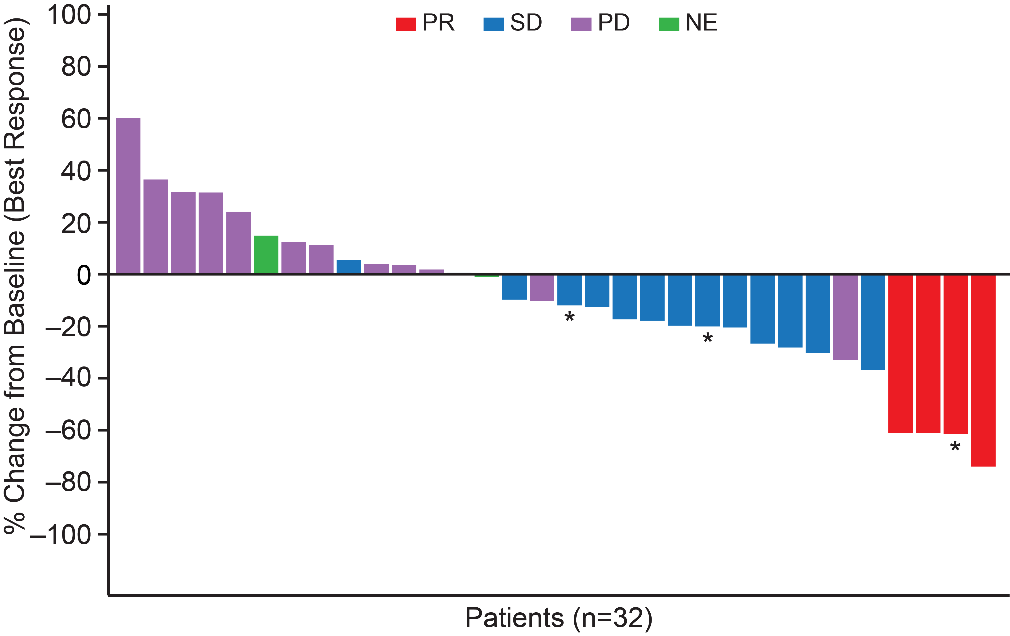
Efficacy: PF-07248144 5 mg QD Monotherapy
Median follow-up: 15.9 months (range 13.8–NE)
ORR: 11.4% (95% CI: 3.2–26.7)
DOR: median 12.0 months (range 7.4–NE)
CBR: 31.4% (95% CI: 16.9–49.3)
PFS: median 3.3 months (95% CI: 2.0–5.8)
*ongoing
CBR=clinical benefit rate; DOR=duration of response; NE=not evaluable; ORR=objective response rate; PD=progressive disease; PFS=progression-free survival; PR=partial response; SD=stable disease
Notes:
[[DRAFT]]
For monotherapy (n=35), the objective response rate (ORR; 95% CI) was 11.4% (3.2, 26.7), median (range) duration of response (DOR) was 12.0 mos (7.4, NE), and clinical benefit rate (CBR; 95% CI) was 31.4% (16.9, 49.3).
* indicates ongoing. Data cutoff

Slide 11
Baseline Characteristics: PF-07248144 5 mg QD + Fulvestrant
Age: Median 55.0 years
(range 24.0–76.0)
Female: 42 (97.7%)
Race: Asian (67.4%) White (30.2%) Black/African American (2.3%)
ECOG PS: 0 (39.5%) 1 (60.5%)
Prior therapies | Combination PF-07248144 5 mg QD + fulvestrant 500 mg (N=43)
Systemic therapy in advanced/metastatic setting, median (range) | 1.0 (1–6)
Prior CDK4/6 inhibitors, n (%) | 43 (100)
Prior CDK4/6 inhibitors ≥12 months, n (%) | 33 (76.7)
Prior ET in advanced/metastatic setting, median (range) | 1.0 (1–3)
Prior ET, n (%) | 43 (100)
Prior aromatase inhibitors, n (%) | 38 (88.4)
Prior fulvestrant, n (%) | 5 (11.6)
Prior chemotherapies in advanced/metastatic setting, median (range) | 0.0 (0–3)
Prior chemotherapy, n (%) | 12 (27.9)
Prior other targeted therapies (mTOR and PIK), n (%) | 2 (4.7)
ESR1 mutant, n/N (%) | 24/42 (57.1)
ECOG PS=Eastern Cooperative Oncology Group performance status; ET=endocrine therapy; mTOR=mammalian target of rapamycin; PIK=phosphoinositide kinases; QD=once daily
Notes:
[[DRAFT]]
43 patients received PF-07248144 in combination with fulvestrant.
Median age was 55.0 years (24.0–76.0), 42 (97.7%) patients were female.
Median (range) prior lines of systemic therapy in the metastatic setting were 1 (1–6).

Slide 12
Tolerable Safety: PF-07248144 5 mg QD + Fulvestrant
Most frequent TRAEs (≥20%) | Combination PF-07248144 5 mg QD + fulvestrant 500 mg (N=43)
By Preferred Term, n (%) of patients with any AE | All grade | Grade ≥3
With Any Adverse Event | 43 (100.0) | 25 (58.1)
Dysgeusia | G1: 25 (58.1) G2: 11 (25.6) | 0
Neutropenia | 28 (65.1) | G3: 18 (41.9) G4: 1 (2.3)
Fatigue | 18 (41.9) | 1 (2.3)
Anemia | 18 (41.9) | 4 (9.3)
Leukopenia | 14 (32.6) | 5 (11.6)
Median follow-up: 9.2 months (range 7.2–11.0)
Most frequent TRAEs:
dysgeusia (most G1); no dose reduction or treatment discontinuation due to dysgeusia
Most frequent G≥3 TRAEs: were neutropenia (44%), manageable with dose modifications; no febrile neutropenia observed
No G5 TRAEs reported
Dose reduction due to AEs: 48.8%; reduction within the first 3 cycles, 23.3%
Discontinuations due to AE: 3 (7.0%)
AE=adverse event; G1-4=grade 1-4; QD=once daily; TRAE=treatment-related AE
Notes:
[[DRAFT]]
No Grade 5 AEs
All 43 patients (100%) reported at least one all-causality TEAE of any grade.
27 (62.8%) reported Grade ≥3 TEAEs
The most frequent (≥10%) Grade ≥3 TEAEs were neutropenia (44.2%), leukopenia and anemia (11.6% each)
Any grade TRAEs were reported in 43 (100.0%) patients.
Grade ≥3 TRAEs were reported in 25 (58.1%) patients.
Grade ≥3 TRAEs in more than one patient included neutropenia (Grade 3, n=19 [44.2%]; Grade 4, n=1 [2.3%]), leukopenia (Grade 3, n=5 [11.6%]), and anemia (Grade 3, n=4 [9.3%])
Neutropenia was reversible and well managed with dose modification

Slide 13
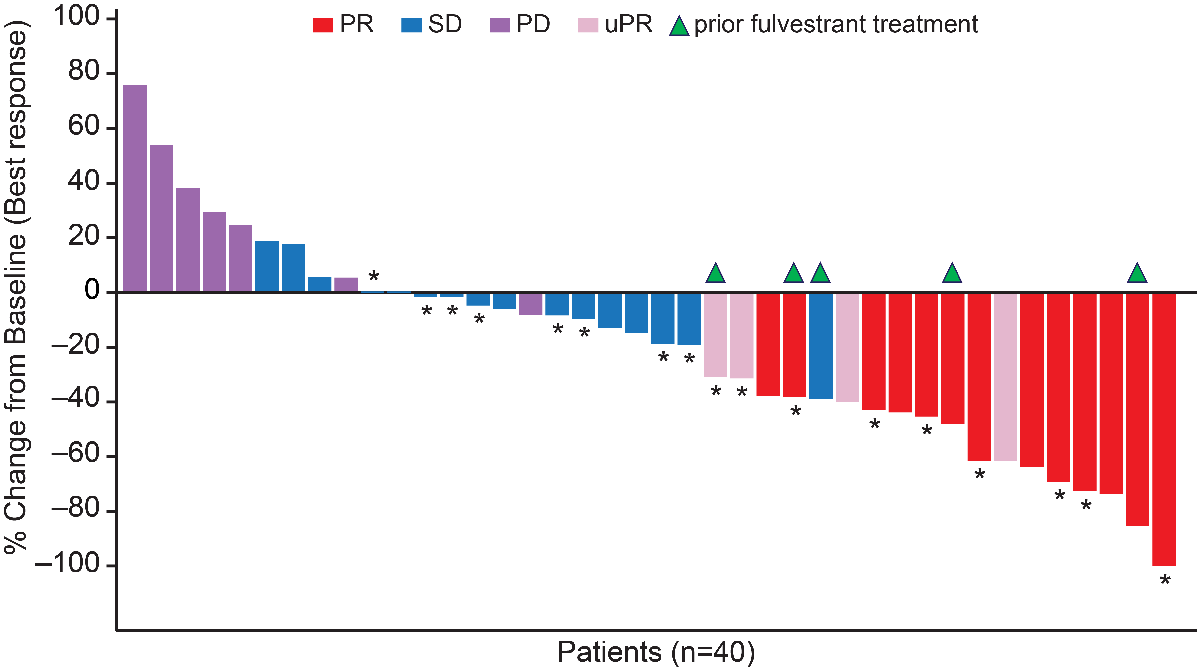
Encouraging Efficacy: PF-07248144 5 mg QD + Fulvestrant
Median follow-up: 9.2 months (range 7.2–11.0)
ORR: 30.2% (95% CI: 17.2–46.1)
DOR: median 9.2 months (range 7.2–NE)
*ongoing
5 patients had prior fulvestrant treatment:
3 had confirmed PR
1 had unconfirmed PR
DOR=duration of response; NE=not evaluable; ORR=objective response rate; PD=progressive disease; PR=partial response; SD=stable disease; uPR=unconfirmed partial response
Notes:
[[DRAFT]]
For the PF-07248144 5 mg QD and fulvestrant combination (n=43), the median duration of follow-up of 9.2 mos, the ORR was 30.2% (17.2, 46.1), median DOR was 9.2 mos (7.2, NE), CBR was 51.2% (35.5, 66.7), 5 pts progressed after Fulv Reference Fulvestrant monotheray

Slide 14
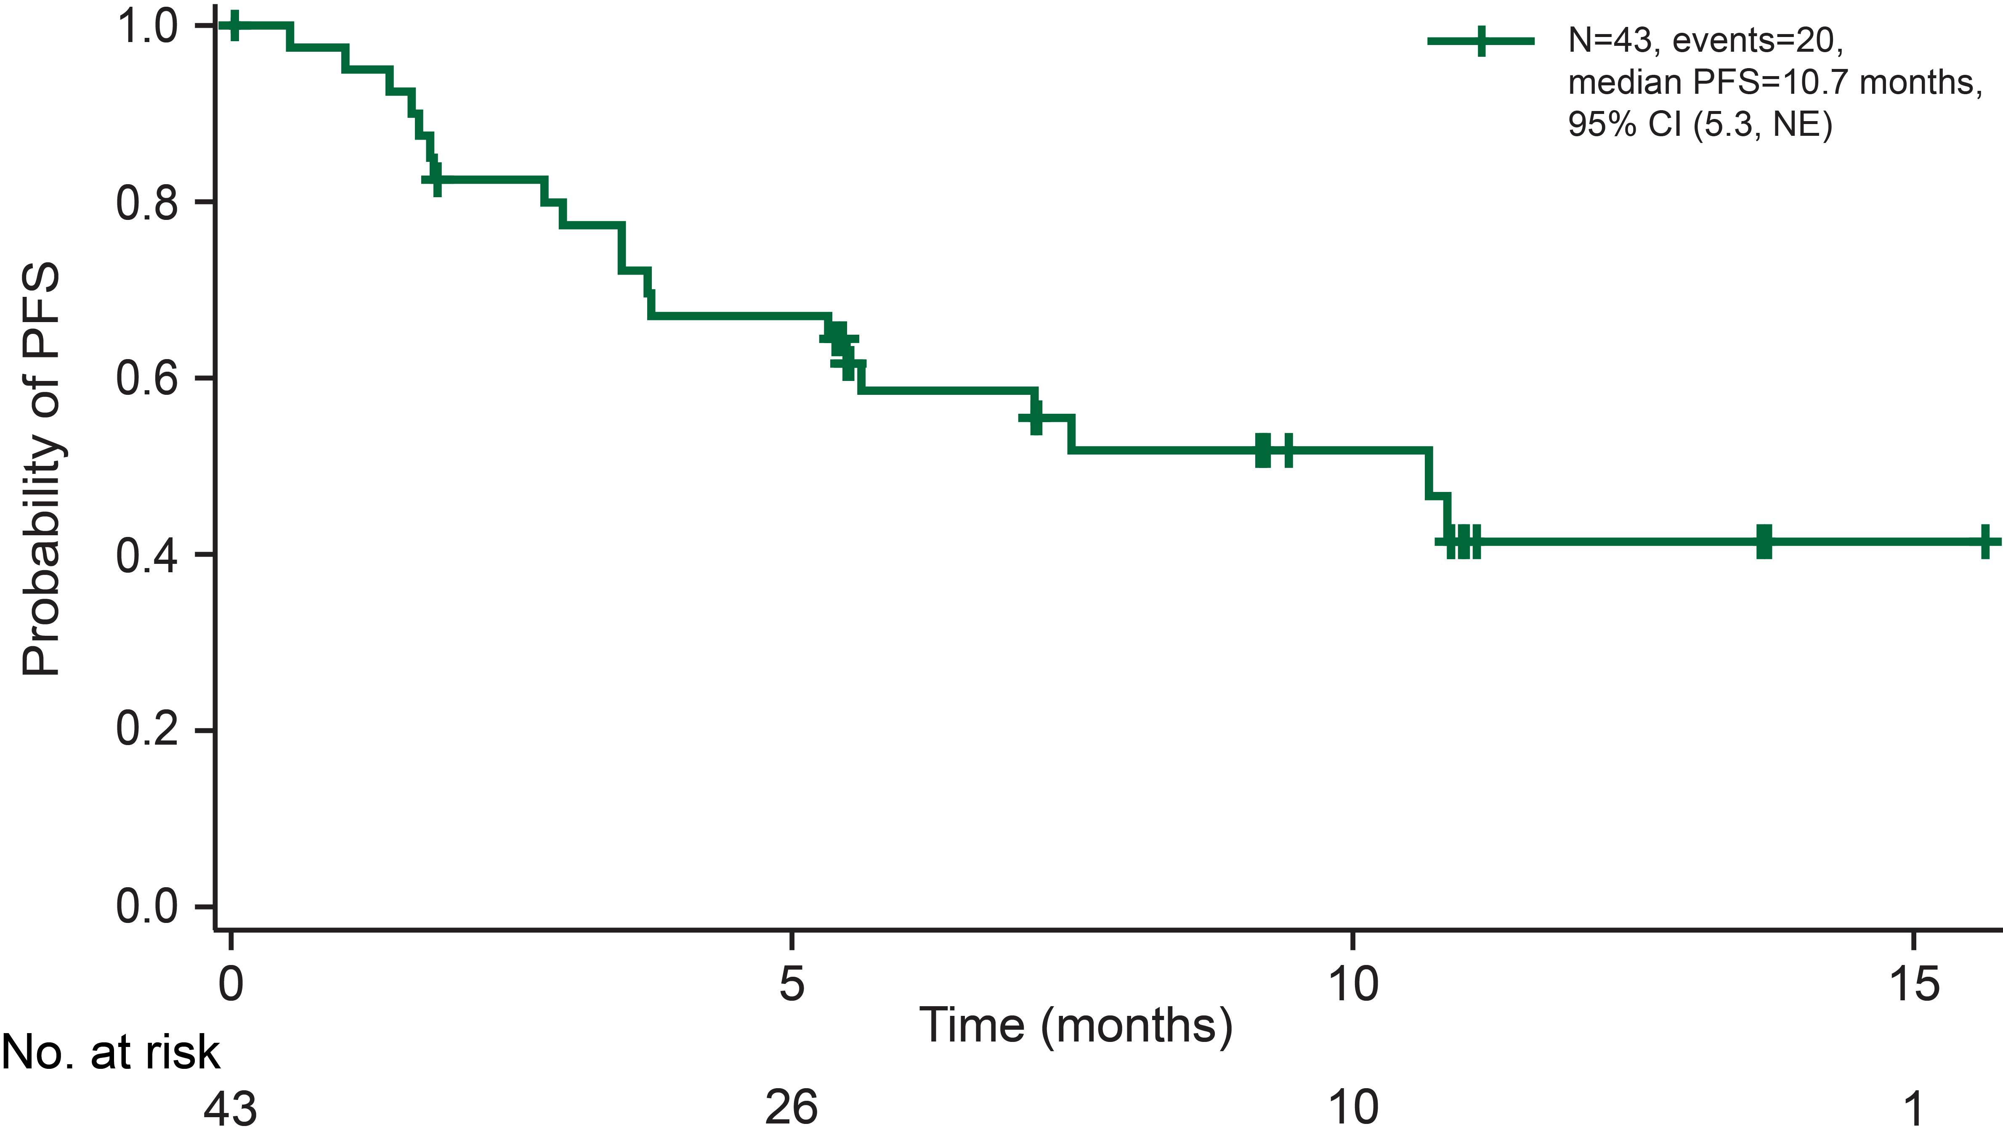
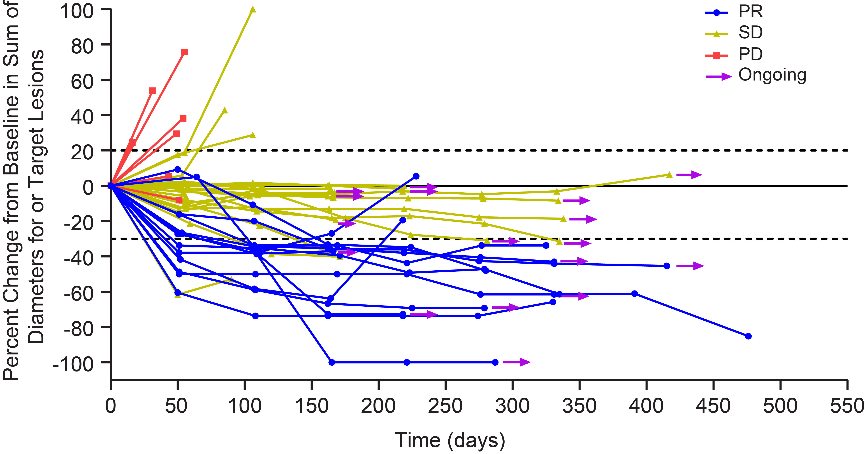
Encouraging Efficacy: PF-07248144 5 mg QD + Fulvestrant
CBR: 51.2% (95% CI: 35.5–66.7)
Ongoing: n=17
Median follow-up: 9.2 months (range 7.2–11.0)
PFS: median 10.7 months (n=43) (95% CI: 5.3–NE)
BOR (confirmed), N=40
BOR=best overall response; CBR=clinical benefit rate; PD=progressive disease; PFS=progression-free survival; PR=partial response; SD=stable disease (including unconfirmed PRs)
Notes:
[[DRAFT]]
The median progression-free survival (mPFS) was 10.7 mos (n=43; 95% CI 5.3, NE).

Slide 15
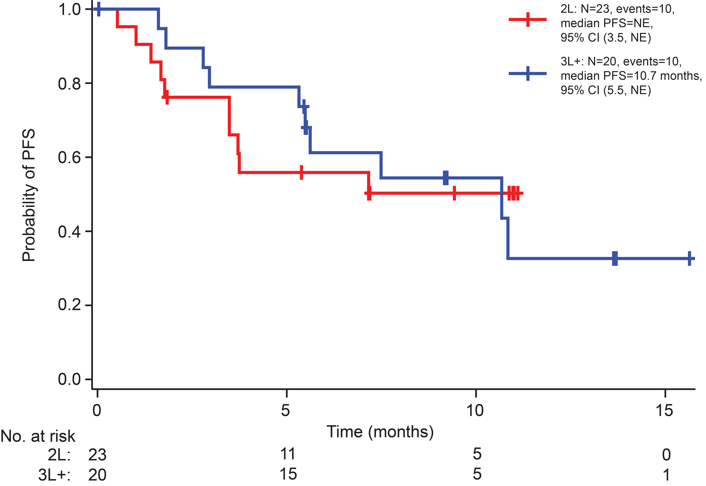
PF-07248144 5 mg QD + Fulvestrant: Consistent Activity Across 2L and 3L+
 | 2L (n=23) | 3L+ (n=20)
ORR, % | 21.7 | 40.0
95% CI | 7.5–43.7 | 19.1–63.9
CBR, % | 43.5 | 60.0
95% CI | 23.2–65.5 | 36.1–80.9
Median PFS | Not reached | 10.7 mo
95% CI | 3.5–NE | 5.3–NE
CBR=clinical benefit rate; L=line; NE=not evaluable; ORR=objective response rate; PFS=progression-free survival
Notes:
[[DRAFT]]
23 patients received PF-07248144 and fulvestrant as the second-line therapy in advanced or metastatic setting
The ORR was 21.7% (95 % CI: 7.5–43.7, and the CBR was 43.5% (95 % CI: 23.2–65.5).
20 patients received PF-07248144 and fulvestrant as the third-line and above [3L+] treatment
The ORR was 40.0% (95 % CI: 19.1–63.9), and the CBR was 60.0% (95 % CI: 36.1–80.9). The mPFS was 10.7 months (95% CI: 5.5–NE)
3 confirmed PRs observed in 5 patients who had received prior Fulvestrant

Slide 16
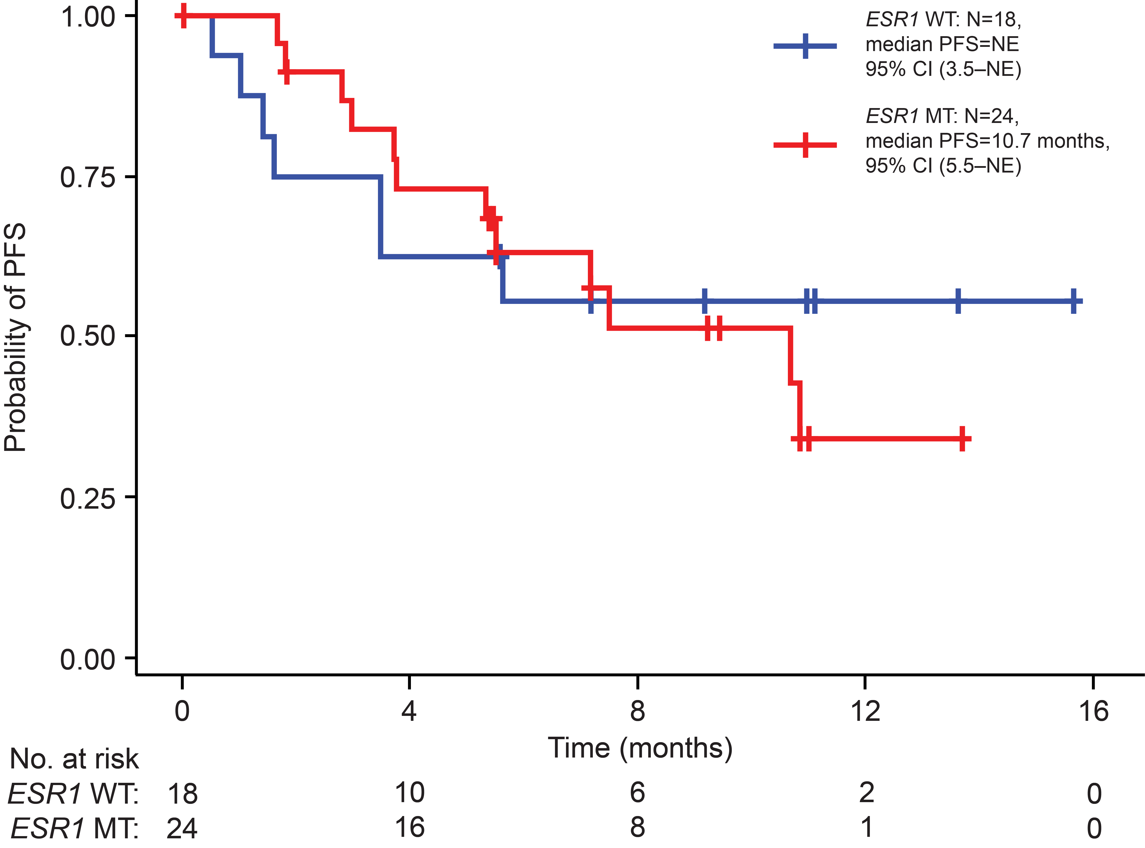
PF-07248144 5 mg QD + Fulvestrant: Consistent Activity Irrespective of ESR1 Mutation Status
ESR1 | MT (n=24) | WT (n=18)
ORR, % | 33.3 | 27.8
95% CI | 14.5–52.2 | 7.1–48.5
mPFS, mo | 10.7 | Not reached
95% CI | 5.5–NE | 3.5–NE
mPFS, ESR1 wild-type vs mutant, HR 0.9; 95% CI: 0.4–2.3; P=0.827
HR=hazard ratio; mPFS=median progression-free survival; MT=mutant; NE=not evaluable; ORR=objective response rate; WT=wild-type
Notes:
57.1% (24/42) of the patients had one or more gene mutations in ESR1 genes at baseline.
ORR (95% CI) was 33.3% (14.5%–52.2%) and 27.8% (7.1%–48.5%) in patients with ESR1 mutant and ESR1 wild type.
mPFS (95% CI) was 10.7 (5.5–NE) and NE (3.5–NE) months in patients with ESR1 mutant and ESR1 wild type, respectively.
Durable anti-tumor activity of PF-07248144 in combination with fulvestrant was observed in patients regardless of mutation status in ESR1 (mPFS, ESR1 wild type vs mutant, hazard ratio [HR] 0.9; 95% CI: 0.4–2.3; P=0.827)

Slide 17
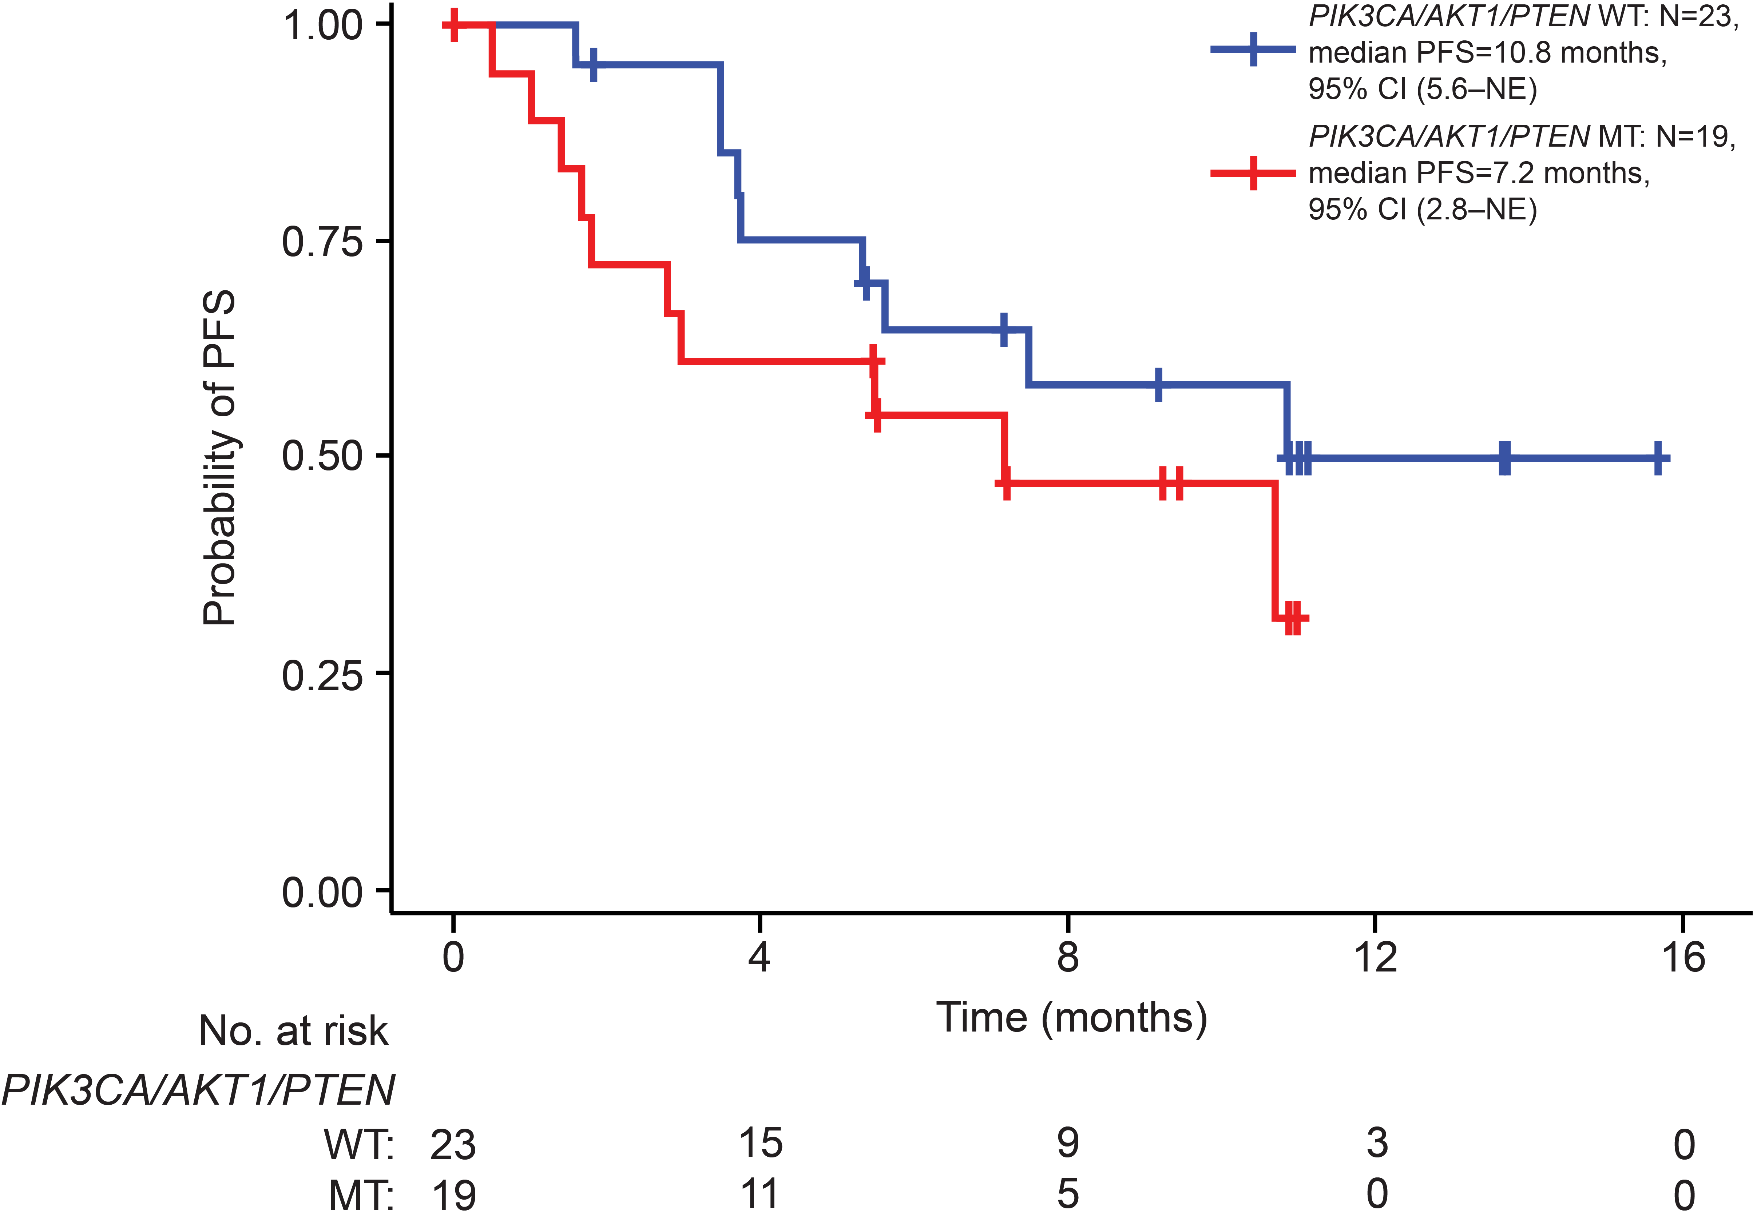
PF-07248144 5 mg QD + Fulvestrant: Consistent Activity Irrespective of PI3K/AKT1/PTEN Mutation Status
PIK3CA/ AKT1/PTEN | MT (n=19) | WT (n=23)
ORR, % | 26.3 | 34.8
95% CI | 6.5–46.1 | 15.3–54.2
mPFS, mo | 7.2 | 10.8
95% CI | 2.8–NE | 5.6–NE
mPFS, wild-type vs mutant, HR 0.6; 95 CI: 0.2–1.4; P=0.209
mPFS=median progression-free survival; MT=mutant; NE=not evaluable; ORR=objective response rate; WT=wild-type
Notes:
45.2% (19/42) of the patients had one or more gene mutations in PIK3CA/PTEN/AKT1 genes at baseline.
ORR (95% CI) was 26.3% (6.5%–46.1%) and 34.8% (15.3%–54.2%) in patients with PIK3CA/PTEN/AKT1 mutant and PIK3CA/PTEN/AKT1 wild type.
mPFS (95% CI) was 7.2 (2.8–NE) and 10.8 (95% CI 5.6–NE) months in patients with PIK3CA/PTEN/AKT1 mutant and PIK3CA/PTEN/AKT1 wild type, respectively.
Durable anti-tumor activity of PF-07248144 in combination with fulvestrant was observed in patients regardless of mutation status in PIK3CA/PTEN/AKT1 (mPFS, PIK3CA/PTEN/AKT1 wild type vs mutant, hazard ratio [HR] 0.6; 95 CI: 0.2–1.4; P=0.209)

Slide 18
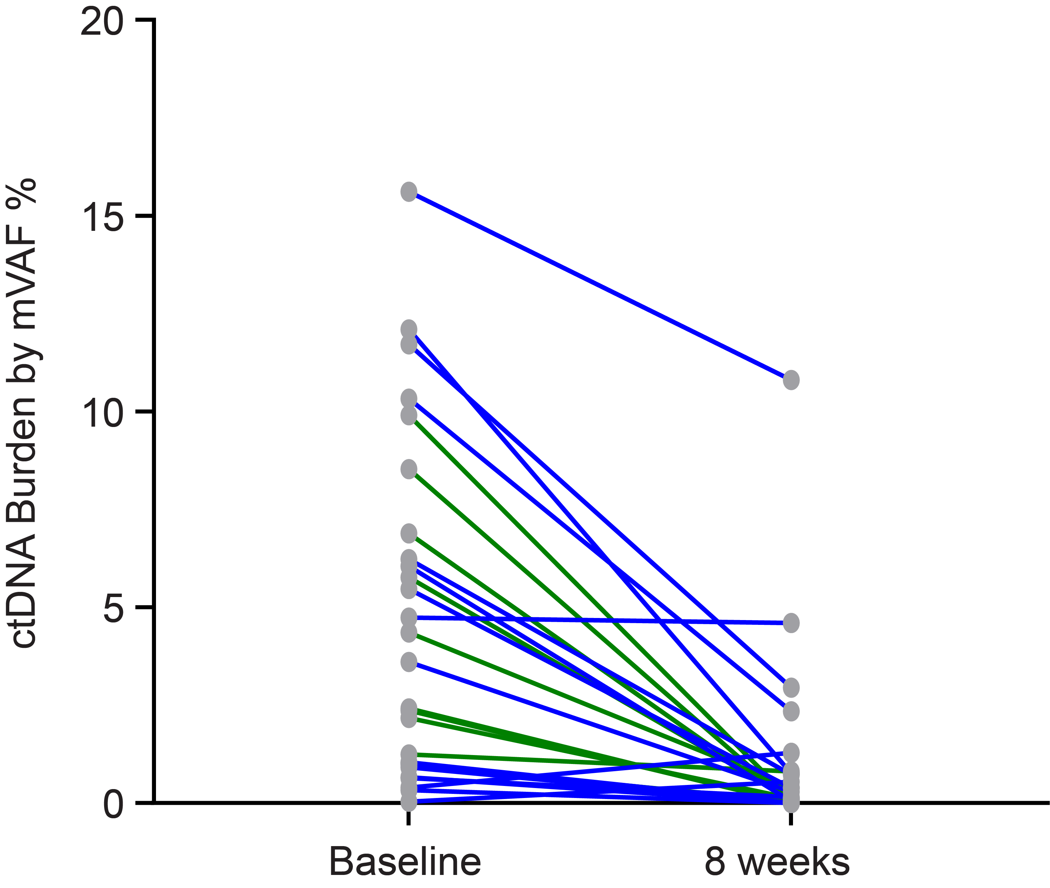
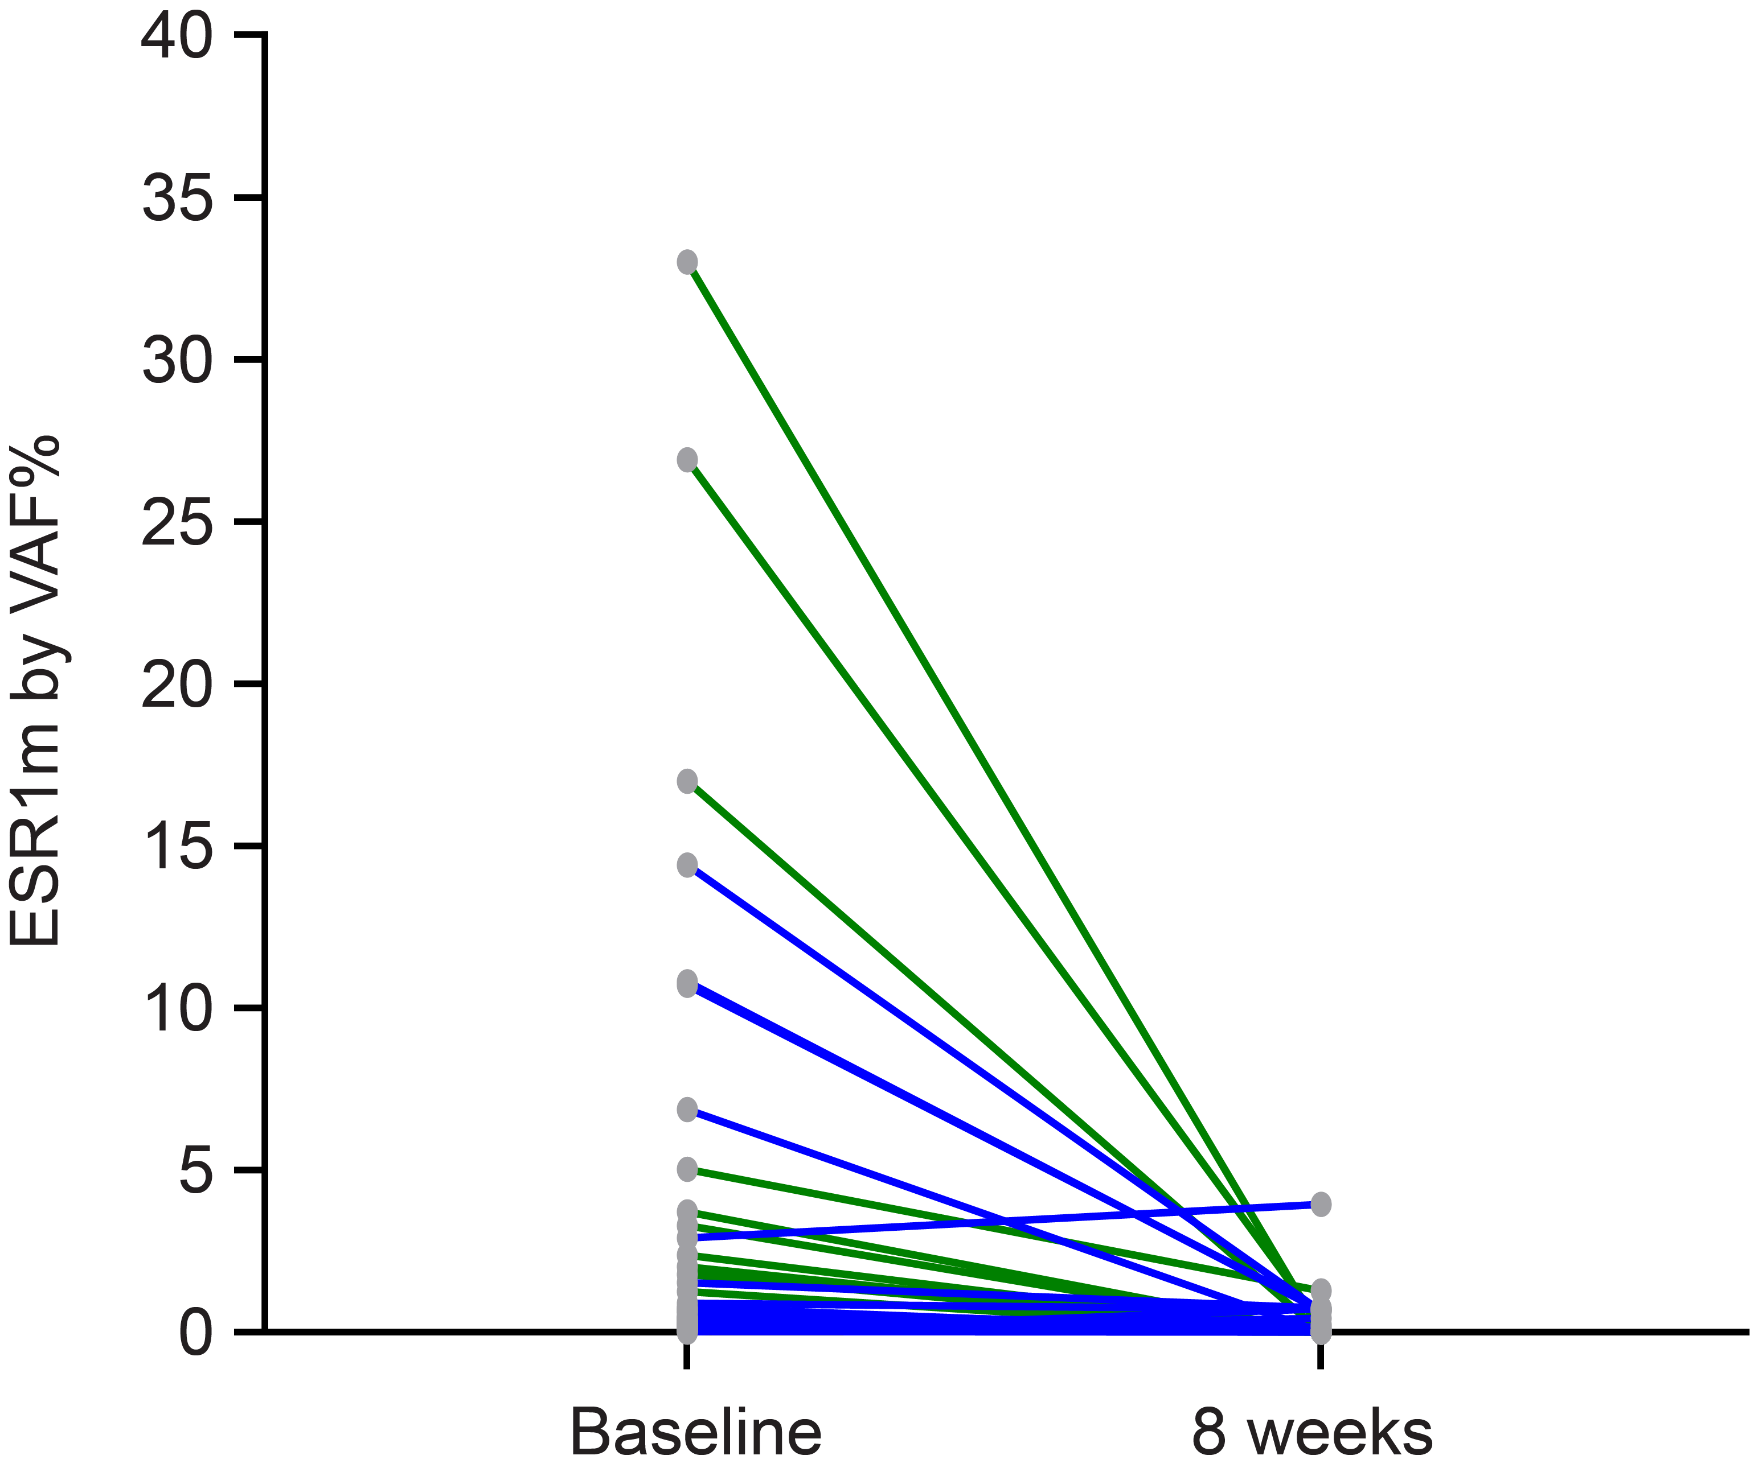
ctDNA Reduction in Patients With Mutation(s) Supports Observed Antitumor Activity
ctDNA mutation burden changes
ESR1 mutant variants changes
PR
PR
SD
SD
Median ctDNA mVAF% | Baseline | 8 weeks | Changes from baseline
All (n=27) | 3.60 | 0.10 | -95%*
PRs (n=10) | 3.39 | 0.07 | -98%
SDs (n=17) | 3.60 | 0.39 | -89%
Median ESR1m VAF% | Baseline | 8 weeks | Changes from baseline
All (n=20, 47 variants) | 0.46 | 0.00 | -100%*
PRs (n=5, 16 variants) | 0.40 | 0.00 | -100%
SDs (n=15, 31 variants) | 0.48 | 0.00 | -100%
ctDNA testing by Guardant 360 assay. * Wilcoxon-test, P<0.0001.
ctDNA=circulating tumor DNA; mVAF=mean of all VAFs; PR=partial response; Rx=treatment; SD=stable disease; VAF=variants allele frequency
Notes:
PF-07248144 plus fulvestrant at 8 weeks showed ctDNA tumor fraction reduction from baseline by 95% in 27 pts with mutation(s) (detected at baseline), and complete clearance of ESR1 mutants in >50% (12/20) of the patients with ESR1 mutations detected at baseline.

Slide 19
Conclusions
PF-07248144 (NCT04606446): first-in-class, potent, selective catalytic inhibitor of KAT6A and 6B
Phase 1 dose escalation established 5 mg QD as the RDE; dose expansion evaluated monotherapy and fulvestrant combination in ER+ HER2– mBC post CDK4/6 inhibitors and ET
Tolerable safety profile at RDE (n=78, data cutoff: September 30, 2023); most frequent TRAE: dysgeusia; most frequent G≥3 TRAE: neutropenia
Encouraging activity:
Monotherapy antitumor activity
PF-07248144 + fulvestrant (n=43) efficacy: ORR 30.2%, mDOR 9.2 months, and mPFS 10.7 months
Fulvestrant combination: consistent activity observed in patients with 2L and 3L+, irrespective of ESR1 and PIK3CA, AKT1, and PTEN mutation status
Significance: Establish KAT6A and 6B as druggable cancer targets, provide clinical proof of concept, and support future investigation in HR+ mBC
These findings establish KAT6A and 6B as druggable cancer targets, provide clinical proof of concept, and identify a potential new avenue to treat patients with HR+ HER2– mBC

Slide 20
Publication
For illustration ONLY. Will be updated with the publication.
Toru Mukohara, Yeon Hee Park, David Sommerhalder, Kan Yonemori, Erika Hamilton, Sung-Bae Kim, Jee Hyun Kim, Hiroji Iwata, Toshinari Yamashita, Rachel M. Layman, Monica Mita, Timothy Clay, Yee Soo Chae, Catherine Oakman, Fengting Yan, Gun Min Kim, Seock-Ah Im, Geoffrey J. Lindeman, Hope S. Rugo, Marlon Liyanage, Michelle Saul, Christophe Le Corre, Athanasia Skoura, Li Liu, Meng Li, Patricia M. LoRusso

Slide 21
Acknowledgments
All participants and their caregivers
All co-investigators
Clinical research teams at the participating sites
Pfizer research and development team
The study is sponsored by Pfizer Inc
Medical writing support was provided by Shuang Li, PhD, CMPP, of Engage Scientific Solutions and was funded by Pfizer

Slide 22


Oral Presentation and Abstract Plain Language Summary
Please scan this quick response (QR) code with your smartphone app to view this oral presentation.
If you do not have a smartphone, access the oral presentation via the internet at: https://meetings.asco.org/abstracts-presentations/238945
Please scan this QR code with your smartphone app to view a plain language summary.
If you do not have a smartphone, access the plain language summary via the internet at:
https://scientificpubs.congressposter.com/pls/ka8w4ypsrboh76qq
Copies of these materials obtained through QR code are for personal use only and may not be reproduced without permission from ASCO® or the authors of these materials.

