Slide 1

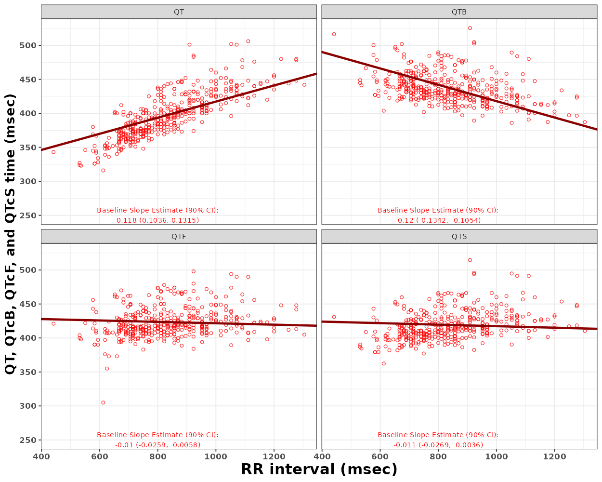
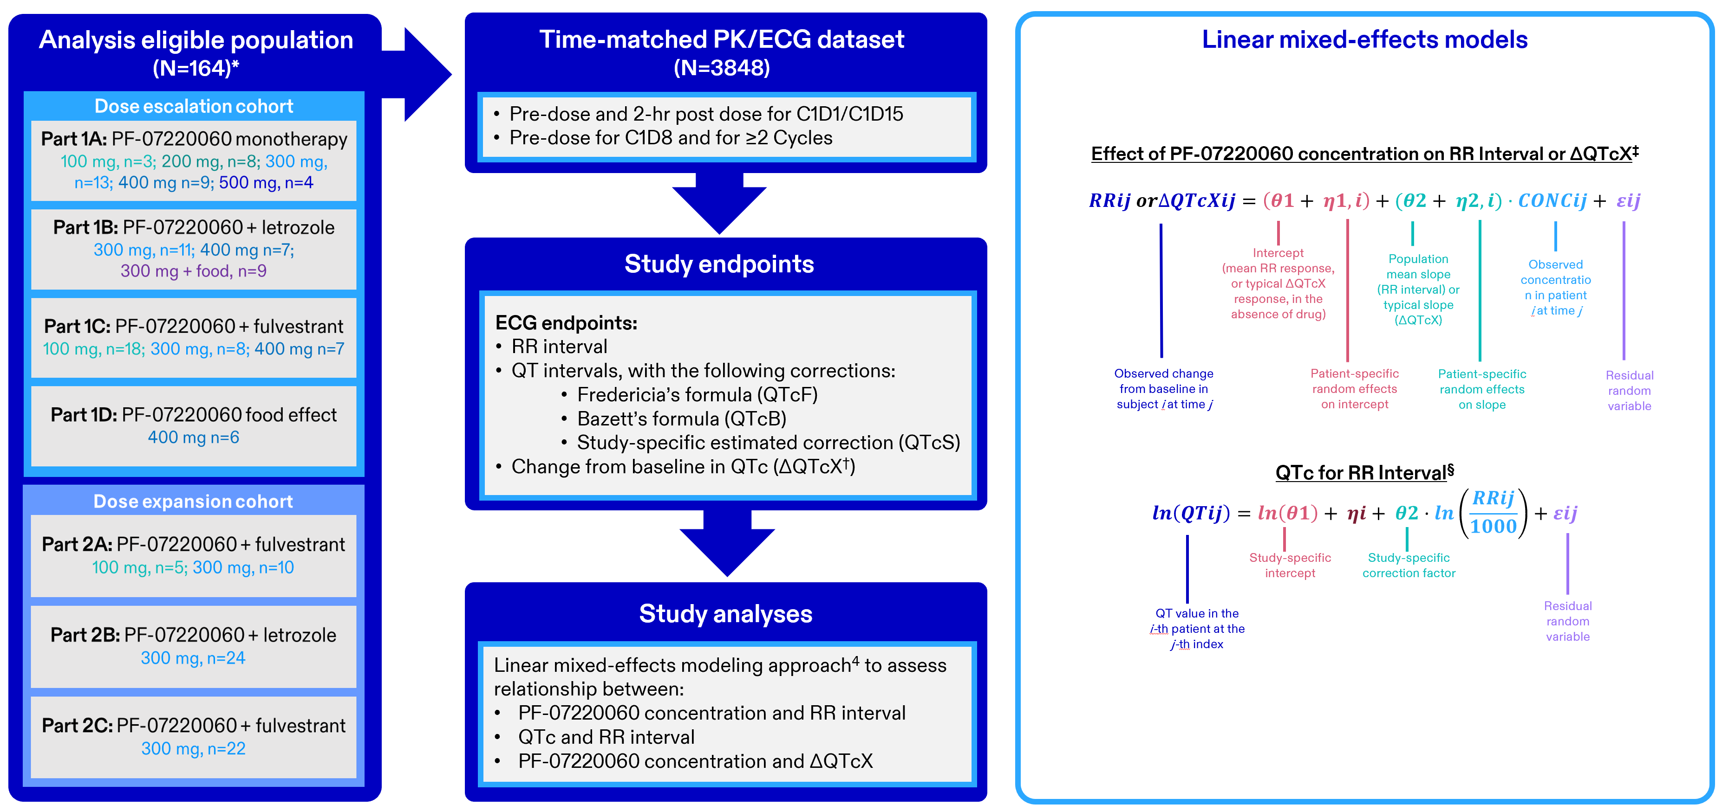
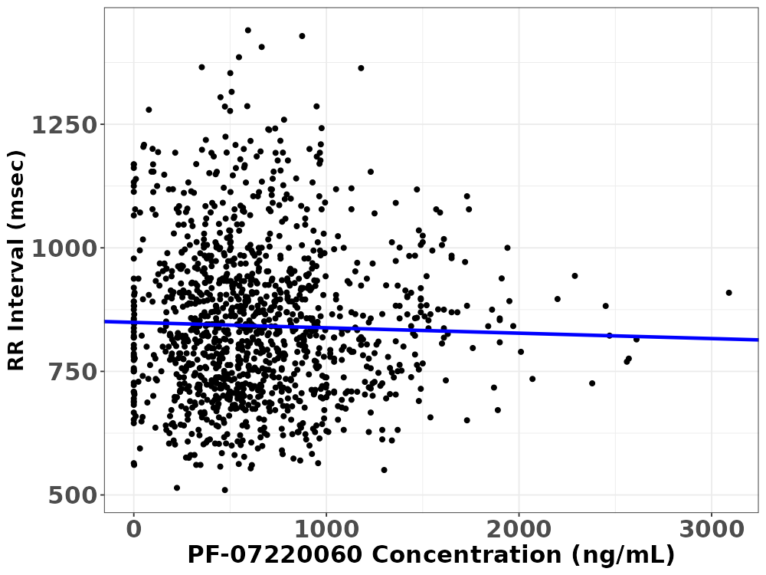
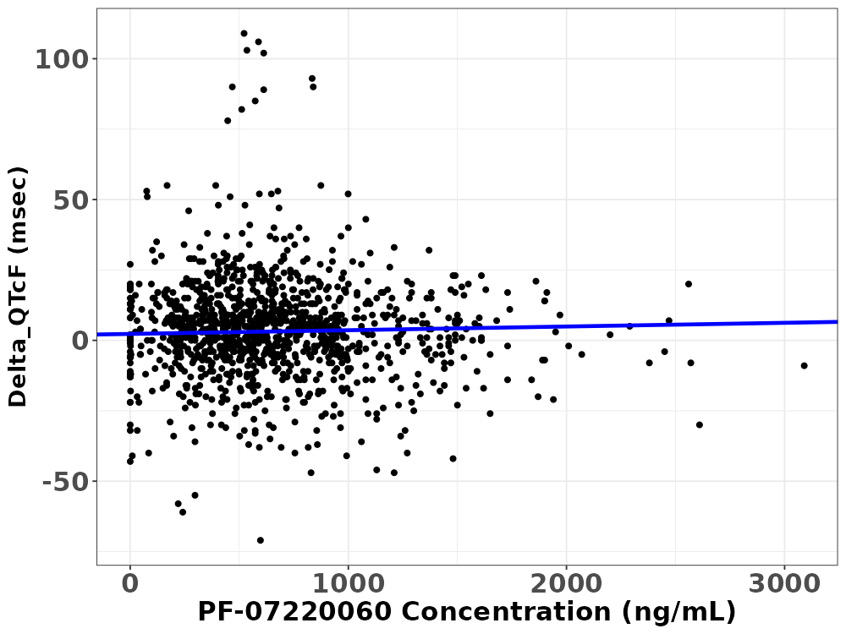

W-070
Concentration-QTc analysis of PF-07220060 in patients with advanced solid tumors
Xizhe Gao¹, James Ousey², Maria Delioukina³, Li Zhou³, Jason H. Williams⁴, Justin T. Hoffman³, Jing Yang⁵
¹Pfizer Inc., South San Francisco, CA, USA; ²Arrowhead Pharmaceuticals, Pasadena, CA, USA; ³Pfizer Inc., San Diego, CA, USA; ⁴Exelixis, Alameda, CA, USA; ⁵Boundless Bio, San Diego, CA, USA
Objective
To assess the impact of PF-07220060 plasma level on cardiovascular parameters (RR-interval and QT-interval) in patients with advanced solid tumors enrolled in the ongoing first-in-human, open-label, nonrandomized, multiple dose phase 1/2a study
Conclusion
Initial concentration-QT analysis indicates that the effect of PF-07220060 on heart rate was minimal, and that PF-07220060 does not have a concentration-dependent impact on QTcF, suggesting a low potential for QT prolongation at clinical doses to be evaluated in the future studies
Background
PF-07220060 is a next-generation, highly selective, potent, oral CDK4 inhibitor (CDK4i) with significant sparing of CDK6 blockade that is currently being investigated in patients with metastatic or advanced solid tumors, with a focus on HR+/HER2− metastatic breast cancer¹
Initial phase 1 clinical trial data (NCT04557449) indicated PF-07220060 has a favorable safety and efficacy profile in patients who were CDK4/6 inhibitor (CDK4/6i)-naïve as well as those who were previously treated with (and developed resistance to) CDK4/6i^{2,3}
A dog telemetry study demonstrated that at the top dose of 100 mg/kg/day, PF-07220060 produced small increases in heart rate with concomitant effectual decreases in RR- and QT-intervals with no changes in QTc
Results
The linear relationship between QT and RR at baseline was adequately eliminated by both Fridericia and study-specific corrections, with no distinct difference between Fridericia and study-specific corrections; so, QTcF was chosen for concentration vs ΔQTc analyses (Figure 2)
For both concentration vs RR-interval
and concentration vs ΔQTcF linear mixed effect models, only the model with random effect on intercept converged successfully; so, the model with patient-specific random effect on intercept was selected as the final model
Figure 2. Individual QT/QTc vs RR Interval at Baseline
The linear relationship between PF-07220060 concentrations and RR-interval had a negative slope (−0.01091 msec/ng/mL, with 90% CI: −0.0217, −0.0001) (Figure 3a) with the model parameter estimates reported in Table 1a
With a slope of 0.00131 msec/ng/mL (90% CI: −0.00043, 0.00306), PF-07220060 concentrations had no effect on ∆QTcF (Figure 3b) and had the model parameter estimates reported in Table 1b
Materials and Methods
Figure 1. Study Design
Solid line represents model predicted response
Figure 3. PF-07220060 Concentration vs RR Interval and vs ΔQTc
3a
3b
*Detailed patient eligibility criteria for inclusion in the phase 1/2a study (NCT04557449) can be found at ClinicalTrials.gov. †QTcX: QTcF/QTcB/QTcS. ‡Drug’s effect on RR-interval and ∆QTcX at steady-state C_{max} was predicted with geometric mean of C_{max} at C1D15. The upper boundary of the 90% CI for the mean effect was compared with the threshold for regulatory concern as defined in ICH E14 guidance. §Only the baseline and screening RR and QT values were used to estimate the study-specific correction factor. Each QT correction factor was evaluated graphically and the degree of trend or correlation remaining in the plots of Baseline/Screening QTc values vs Baseline/Screening RR values were assessed quantitatively to determine which correction factor was most appropriate, i.e., the correction method that most adequately controls the RR-QTc correlation (i.e., eliminates the correlation between RR and QTc) was selected for the primary analysis.
A preliminary PK/PD analysis was conducted to explore the relationship between ECG endpoints and plasma PF-07220060 concentration
(PF-07220060: dose range, 100 mg–500 mg BID; plasma concentration ≤3090 ng/mL) based on time-matched PK and triplicate mean ECG data (data cut-off: November 1, 2023; data points outside the +/− 1 hour
time-matching window were excluded from the analysis)
If more than one ECG reading was collected at a nominal time after
dosing, the mean of the replicate measurements was used to represent a single observation at that time point; any data obtained from ECGs repeated for safety reasons after the nominal time points was not
averaged along with the preceding triplicates; no value was imputed for missing data for the analysis of QT corrected for heart rate (QTc )
The ECG endpoints were RR-interval and the change-from-baseline in QTc; to obtain QTc values that are independent of the heart rate, three correction methods were evaluated: Fredericia’s formula (QTcF;
site reported), Bazett’s formula (QTcB), and study-specific estimated correction (QTcS)
A graphical summary and linear mixed-effects modeling approach⁴ was applied, with a 90% confidence interval (CI) of the slope including “zero” being interpreted as PF-07220060 concentration having no statistically significant concentration-dependent effect on the ECG parameter
RR-intervals decreased slightly with increasing drug concentrations, but had minimal effect on heart rate
PF-07220060 did not have a statistically significant concentration-dependent drug effect on QTcF
Table 1a. Model Parameter Estimates for RR-interval vs PF-07220060 Plasma Concentration Relationship
Model Parameter, units | Estimate (90% CL) [Shrinkage] | SE | CV%
θ_{Intercept,} msec | 849.12 (831, 868) | 11.1 | 1.31
θ_{Slope}, msec/ng/mL | -0.01091 (-0.0217, -0.0001) | 0.00658 | -60.4
BSV-intercept, msec [shrinkage] | 131.7 [3.3] | -- | --
Residual SD, msec [shrinkage] | 74.9 [6.7] | -- | --
BSV, between subject variability; CL, confidence limits; CV, coefficient of variation; msec, millisecond; SE, standard error
Table 1b. Parameter Estimates for the Relationship Between ∆QTcF and PF-07220060 Plasma Concentration for the Final Model
Model Parameter, units | Estimate (90% CL) [Shrinkage] | SE | CV%
θ_{Intercept,} msec | 2.29 (0.2, 4.4) | 1.28 | 55.9
θ_{Slope}, msec/ng/mL | 0.00131 (−0.00043, 0.00306) | 0.00106 | 80.9
BSV-intercept, msec [shrinkage] | 12.6 [8.1] | -- | --
Residual SD, msec [shrinkage] | 12.1 [6.0] | -- | --
BSV, between subject variability; CL, confidence limits; CV, coefficient of variation; msec, millisecond; SE, standard error
Both 100 mg BID and 300 mg BID doses were evaluated for dose optimization; predicted change from baseline in heart rate and QTcF at the observed steady-state geometric mean C_{max} of PF-07220060 at doses of 100 mg BID and 300 mg BID are reported in Table 2
Even at 2x concentration of steady state geometric mean C_{max} at 300 mg BID, the upper bound of 90% CI for predicted ∆QTcF was less than the ICH E14 standard for regulatory concern (10 msec)
Electronic Poster
An electronic version of this poster may be obtained by scanning this QR code with your smartphone app. Copies of this poster obtained through the QR Code are for personal use only and may not be reproduced without permission from ACoP and the author of this poster. To request permission or to ask questions about the poster please contact: emma.gao@pfizer.com
Table 2. Predicted Drug Effect on Heart Rate and ∆QTcF
 | Predicted change in heart rate* from baseline (bpm) | Predicted ∆QTcF (msec)
Geometric mean C_{max} at 100 mg (720.2 ng/mL) | 0.57 (90% CI: 0, 1.14) | 1.3 (90% CI: 0, 2.6)
Geometric mean C_{max} at 300 mg (1221 ng/mL) | 0.97 (90% CI: 0.01, 1.95) | 3.9 (90% CI: 1.9, 5.9)
2-fold higher than C_{max} at 300 mg (2442 ng/mL) | -- | 5.5 (90% CI: 1.9, 9.1)
*Heart rate (bpm) = 60000/RR (msec); bpm, beats per minute; msec, millisecond
References: 1. Yap, TA., et al. JCO. 2023;41:3009. 2. Yap, TA., et al. ESMO Open. 2024;9. 3. Giordano, A., et al. JCO. 2024;42:3108. 4. Garnett, C., et al. J Pharmacokinet Pharmacodyn. 2018;45:383–97.
Disclosures: XG, MD, LZ and JT are employees of Pfizer; JO, JHW and JY were employed by Pfizer when the study was conducted.
Acknowledgments: This study was sponsored by Pfizer Inc. Medical writing and poster preparation support was provided by Meenakshi Mukherjee, PhD; Bhawana George, PhD; and Sonia Philipose, PhD (all employees of Pfizer), and was funded by Pfizer.
Copyright ©2024. All rights reserved.
Presented at the American Conference on Pharmacometrics (ACoP) Annual Meeting • November 10–13, 2024 • Phoenix, AZ, USA

